Slide 1
Eagle stream ODMs CRD survey Report
(server segment)
CONFIDENTIAL
Contained customer process information under NDA
Customer participated :
Inventec (SH & TW), Wistron ZS, Quanta (SH & TW), Foxconn TJ, Pegatron TW
20ww32 Rev 1

Slide 2
Agenda
Server Customer Manufacturing
PCBA Material / Consumables
    Technology & Process
PCBA Machine / Equipment
    Process Parameter & Capability
      Paste Print, PnP, Reflow, Wave Solder, Rework, Inspection (SPI, AOI)
Others & Automation
    PHM Assembly, Manufacturing Test, System Integration
Key Takeaway
Next Step

Slide 3
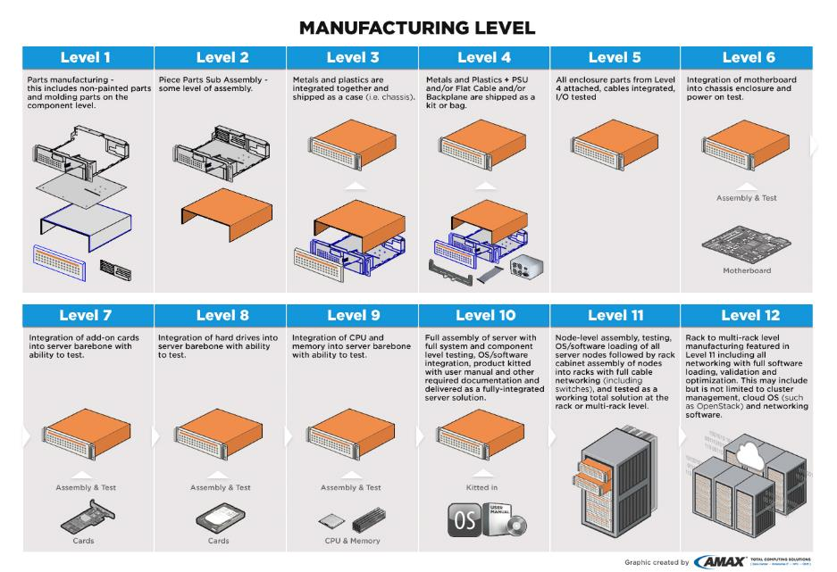
Server Manufacturing Level & Customer Landscape
Enterprise Customer : Dell, HP, Lenovo
CSP Customer : FB, Amazon, MSFT, Google
ODM (Board)
ODM Sys Integration
OxM Sys Integration
PCBA & Board assembly
Level | Description
L6 | Integration of motherboard into chassis enclosure and power on test.
L10 | Full assembly of server with full system and component level testing, OS/software integration, product kitted with user manual and other required. Documentation and delivered as a fully-integrated server solution.
L11 | Node-level assembly, testing, OS/software loading of all server nodes followed by rack cabinet assembly of nodes into racks with full cable networking (including switches), and tested as a working total solution at the rack or multirack level.
L6 Board
L10 System
L10 System
L10 System
L11/L12 System

Slide 4
PCBA Material / Consumables
Data Source: Server ODMs
Material | Inventec | Quanta | Foxconn TJ | Wistron ZS | Pegatron TW
Stencil | Local supplier | Local supplier | Foxconn; 深精藝-SHENJINGYI; 蒙瑞-MENG RUI | Local supplier | Iden Win-laser
PCB | Local supplier | Gold Circuit, Tripod, ISU | GCE; BTK; Tripod | Hannstar, Boardtek, GCE | ACCL, GCE, Compeq
Solder Paste (SMT) | Shenmao PF606-P | Shenmao PF606-P Shenmao PF606-P245 | ALPHA OM338PT Senju M705-S101HF-S4 | Shenmao PF606-F Henkel GC-10 | Shenmao PF606-P SMIC M705-S101HF(N6)-S5
Rework | Not provided | SRT/Summit 1800 | Conceptronic/ Feedom2000 | SRT 1100LX, 2200LX | SUMMIT-Lxi
Paste/Flux (Rework) | Not provided | Shenmao PF606-P Shenmao PF606-P245 | Alpha OM338PT | Shenmao SMF-2 | Not provided
Flux (Wave solder) | Shenmao SM816 | Shenmao SM816 | Not provided | Shenmao SM816, Alphametal EF-6808HF | Shenmao SM-827
Key Message :
Prefer Stencil local vendors for fast response, delivery time & on-site support.
Wave solder process is still required for thru-hole components.
Shenmao paste/flux is commonly used except Foxconn.
  Shenmao paste is generally used during early development; will be used as back-up during mass production (MP).
  Alternate solder paste is mandatory for SMT per their customer requirement.

Slide 5
PCBA Material / Consumables & Technology
Data Source: Server ODMs
Material | Technology | Inventec | Quanta | Foxconn TJ | Wistron ZS | Pegatron TW
Stencil | Cut / Coating | laser cut + nano coat | Laser cut | electroform, laser cut with electro polish + nano coat | Laser cut with electro polished | Laser cut with etching
 | Thickness (mils) | 4 & 5 | 5 | 4 (typical) | 5 (per MAS) | 5
 | Step up/down (mils) | Yes, 4, 6 & 8 | Yes, 4 - 6 | Yes, 3, 5, 6, 7, 8 & 10 | Yes, +1 | Yes, 4 – 6
PCB | Surface Finished | OSP | ENIG, OSP, ImAu & etc | OSP | OSP (majority), ENIG (few) | OSP
 | Thickness (mils) | Not provided | 62, 79, 98 & 118 | 62 & 98 | 62, 98, &118 | 79
 | Type | Not Provided | Type 4 | Not Provided | Not Provided | Type 4
Key Message :
Stepped stencil is very common for server ODMs, due to board design complexity (eg, large socket/ connectors and small passive components). Stepped up/down range between 3 – 10 mils.
Stencil thickness for Intel component 4 – 5 mils .
PCB thickness is within TMDG guideline.

Slide 6
PCBA Machine (Brand & Model)
Data Source: Server ODMs
Area | Inventec | Quanta | Foxconn TJ | Wistron ZS | Pegatron TW
Paste Print | ASM DEK/horizon 03IX | Fuji/GPX-C | ASM DEK/DEK 03i | ASM DEK/ Infinity API; Horizon; Neo Horizon 03iX | DEK/ Neo Horizon 03iX
PnP | Fuji/NXT II | Fuji/AIMEXIII, NXTIII, NXTII | Universal/GSM, Genesisa Panasonic/CM602&CM402 | Panasonic/CM602F0,DT401,NPM | Fuji/NXT M6*14
Reflow | REHM | REHM/VXP-945 ERSA/Hotflow 3/26 XL | Vitronics/XPM²1240 | REHM/ VXP-944, VXP945 (N) | Heller/2043 MK5
Rework | Not provided | SRT/Summit 1800 | Conceptronic/ Feedom2000 | SRT 1100LX, 2200LX | SUMMIT-Lxi
Wave Solder | Speed line/ electra | Ersa Hotflow PowerFlow N2 | Not provided | JT Smart610-H, ChanLong/600CNP-HA | JYI DIANN JT-620L
SPI | TRI-7007L | Parmi Sigma XXL, SAKI BF-3Si (3D SPI), Cyber Optic SE5000L | Not provided | TRI-7007L | TRI-7007 SII
SMT X-ray | VTROX | VTROX V810 XXL | Not provided | Phynix-2D Xray, TRI TR7500L | Nordson DAGE JADE FP
Auto Inspection | TRI-7700 | SAKI BF10Z, (S/S, C/S) BF-3Di-ZS2 (Post W/S) | Not provided | Not provided | Not provided
Key Message :
Wide variety of machine in server ODMs. More challenges in equipment capability assessment & development for future package design.

Slide 7
PCBA Process Parameter/Capability – Paste Printing
Data Source: Server ODMs
Parameter / Capability | Inventec | Quanta | Foxconn TJ | Wistron ZS | Pegatron TW
Squeegee Speed (mm/s) | 20 - 60 | 1 - 200 | 45 | 40 | 40
Squeegee Pressure (Kg) | 8-15 | 1 – 25.5 (automatic control) | 10 | 6 - 9 | 11 - 14
Stencil Separation Speed (mm/s) | 0.2-1 | 5.5 | 0.5 | 0.2~0.8 | 0-1
Under Screen Cleaning frequency (per print) | 1~3 | 1 (Top Side) | Bottom side : 3 Top side : 2 | 1~4 | Bottom side : 4 Top side : 2
Stencil Cleaning Frequency (hrs) | 12 | 2 | 12 | 6 | Not provided
Cleaning Process | Ultrasonic | Ultrasonic | The machine automatically to clean | Ultrasonic | Ultrasonic
PCB support type | Vacuum & clip | Panel Vacuum | support block | Pin or Block | Vacuum and pin
Do you use the same pallet for paste print, PnP and reflow? | No | Yes, if use pallet for paste print (case by case) | Yes, if use pallet for paste print (case by case) | No | By model
Maximum board handling (inch, length x width) | 24 x 20 | 24 x 24 | 24 x 20 | 24 x 20 | 24 x 20
Key Message :
Varies PCB support type used at paste print. Pallet use depend on case/model.
PCB maximum size > 20 inch (width) may require tool upgrade for most customers.

Slide 8
PCBA Process Parameter/Capability – PnP
Data Source: Server ODMs
Parameter / Capability | Inventec | Quanta | Foxconn TJ |  | Wistron ZS | Pegatron TW
Nozzle size / φ (mm) (LGA socket & Intel BGA) | 20, 15 | H08M (45 x 45) H01/H02 (74 x 74) | 8.65, (Universal 340F) |  | 15, (#5401 Nozzle) | 20
Max BGA/socket size capability (mm, x & y) | X:74 Y:74 | X:74 Y:74 | BGA X: 55 Y: 55 | Socket X: 83 Y: 64 | X: 100 Y: 80 | X:74 Y:74
Max BGA/socket weight capability (g) | < 50 | < 90 | < 28.5 |  | < 100 | < 38.5
Using pallet during placement | No | Board type dependent (<1.6 mm thickness) | Yes, if use pallet for paste print (case by case) |  | No | By model (pin support)
Maximum board handling (inch, length x width) | 24 x 21 | 30 x 30 | 24 x 20 |  | 26 x 18 | 21 x 16
min pitch/ball recognition capability | 0.4 pitch/0.25 bump | Lead: 0.24mm Bump: 0.40mm Pin: 0.40mm | 0.4 pitch |  | 0.3 mm | 0.4 mm
Key Message :
LGA/BGA beyond socket-E had reached max weight capability for some customer, need early development roadmap & engagement.
PCB maximum size > 16/18 inch (width) require tool upgrade for Pegatron/Wistron.
PnP ball/lead recognition capability > 0.4 mm pitch.

Slide 9
PCBA Process Parameter/Capability – Reflow
Data Source: Server ODMs
Parameter/ Capability | Inventec | Quanta | Foxconn TJ | Wistron ZS | Pegatron TW
Use of PCB support | Carrier | Bottom : Center support Top : Alloy Carrier | Main board usually use the carrier to support PCB. | Not provided | Special carrier
N2 purging | Yes | Yes | Yes | Yes | Yes
O2 PPM control | < 3000 | < 3000 | < 1000 | < 1000 | < 2000
Air flow control | Yes | Yes, Left to Right (facing the machine) | Yes | No | Not provided
Belt Speed (mm/min) | 900 | 900 | 250 -2030 | 900 | 850-1000
Ramp Rate (°C/s) | ≦ 3 | ≦ 3 | ≦ 3 | ≦ 3 | ≦ 3
Cooling Rate (°C/s) | ≦ 3 | ≦ 3 | ≦ 3 | ≦ 3 | ≦ 3
Peak Temp Range | 230-250 °C | 230-250 °C | 235-255 °C | 230-250 °C | 230-250 °C
Time above Liquidus (s) | 60 - 90 | 60 - 90 | 60 - 120 | 60 - 90 | 60 - 120
Soak Temp Range (s) | 90 -120 | 90 - 120 | 60 – 120 (145 – 175°C) | 90 - 120 | 60 - 120
Delta T across Intel component | 15℃ | 10°C | 5°C | 10°C | 10°C
Number of reflow and cooling zones | 8- ramp,3- reflow,3- cooling | REHM:9/5 ERSA: 9/3 | 12- reflow, 4- cooling | 9- ramp, 4- reflow, 5- cooling | 13 heating, 3 cooling
Key Message :
Customer’s NPI typically followed MAS recommended profile. They customize mass production (MP) profile in order to achieve good yield.
  Peak Temp range of 20 °C due to large components on PCB. Foxconn required range 235-255 °C, others @230-250 °C
  TAL range 60 – 90s for most customer, Foxconn & Pegatron required range 60 -120s.
  Inventec is Delta_T <15°C (vs MAS <10°C).

Slide 10
PCBA Process Parameter/Capability – Wave & Rework
Data Source: Server ODMs
Area | Parameter | Inventec | Quanta | Foxconn TJ | Wistron ZS | Pegatron TW
Wave soldering | Preheat Time (s) | <180 | Not provided | 192 - 240 | by product | 90 - 130
 | Solder Pot Temperature (℃) | 265 - 275 | 265 - 275 | 260 - 270 | 263 - 270 | 270
 | Conveyor Speed (mm/min) | 900 | 500 - 2500 | 600 - 750 | 600 - 800 | 850
 | Components / pitch undergo wave solder | connector, dip capacitor | TH component, >2.5mm pitch | Not provided | E-Cap, DIMM/IO Connectors, etc... > 1.57mm pitch | All PTH component (DIP type)
 | O2 PPM monitor | Not provided | <3000 O2 PPM | <1000 O2 PPM | NA | NA
Rework | Peak Temp Range (°C) | 235 - 250 | 50 - 400 (typo?) | 235 - 255 | 230 – 250 | 230 - 250
 | Time above Liquidus (s) | 30 - 120 | 60 - 90 | 60 - 120 | 60 - 90 | Socket: 60 - 120 BGA: 60 – 90
 | Soak Temp Range and Time | 90 - 120 | 90 - 120 | 60 – 120 (145-175 °C) | 90 – 120 | Socket: 60 - 100 BGA: 60 – 120
 | Max BGA/socket weight capability (grams) | Not provided | < 900 | < 28.5 | < 100 | < 38.5
 | Is N2 used& O2 PPM control ? | Not provided | Yes, <3000 O2 PPM | No, no O2 PPM control | Yes, < 3000 O2 PPM | Not provided
Key Message :
Rework PnP had reached maximum weight capability for Foxconn & Pegatron (<28g).
Rework @ air is still required.
Peak Temp range of 20 °C required to achieve good yield (same as SMT).
Notes:
FXCN wave pitch 4-7 seconds ?

Slide 11
PCBA Process Parameter/Capability – Inspection (1)
Data Source: Server ODMs
Area | Process | Inventec | Quanta | Foxconn TJ | Wistron ZS | Pegatron TW
SPI | Sampling rate | 100% | 100% | 100% | 100% | 100%
 | Min/Max Spec and control limit | not provided | not provided | not provided | not provided | not provided
 | Is SPI Performed on selective components or 100%? | 100% | 100% | 100% | 100% | Yes, selective
 | Maximum board handling capability (inch, length x width) | 26 x 24 | 32 x 24 | 24 x 20 | 26 x 24 | 24 x 20
X-Ray | In line / offline | offline | In-line | offline | AXI for In-line, 2DX-ray for offline | offline
 | sampling rate | Per customer requirement | NPI: 100% MP: Selective (BGA, Socket, TH component) | Sample 5 pcs/lot start, follow by 1 pcs per hour | Not provided | NPI: 100% MP: 1 pcs every 2 hrs
Key Message :
SPI is performed 100% for every PCB.
Post SMT X-ray sampling plan varies by customer due to different run rate & line set-up.

Slide 12
PCBA Process Parameter/Capability – Inspection (2)
Data Source: Server ODMs
Area | Process | Inventec | Quanta | Foxconn TJ | Wistron ZS | Pegatron TW
AOI | In line / offline ? | In-line | In-line | In-line | In-line | Before in line / After off line
 | sampling rate ? | 100% | 100% | 100% | 100% for production | 100% for production
 | How many AOI's are used? | 2 | 4 | 2 | Not provided | 4
 | Where is AOI located? | Post Reflow | Pre-reflow: 2 (CS/SS)*, Post wave solder: 2 (CS/SS) | Post Reflow | Post reflow | Pre-reflow: 2, Post-reflow: 2
 | Is AOI Performed on selective components or 100%? | 100% | NPI: 100% MP: Selective | 100% | 100% | Yes (no detail provided)
 | Maximum board handling capability (inch, length x width) | 26 x 24 | 34 x 27 | 24 X 20 | 26 x 24 | 24 X 20
*C/S – Chip Shooter; S/S – Socket Shooter
Key Message :
100% post-reflow AOI is performed during MP phase by in-line process for all customers.
Only 2 customers performed pre-reflow AOI for early issue detection.

Slide 13
PCBA – Operation & Others
Data Source: Server ODMs
Area |  | Inventec | Quanta | Foxconn TJ | Wistron ZS | Pegatron TW
2D Scanner | Purpose | inventory check, traceability | shop floor scanning for traceability | inventory check, traceability | inventory check, traceability | Traceability
 | Which process | kitting,SMT, etc. | SMT & System Final assembly | All process | IQC, SMT, Assembly/Testing process, Rework process | SMT
 | In line or offline | In line | In-line assembly (SMT/System Assy) | In line traceability | Both In line and offline | In-line
Adhesive | Using adhesive for BGAs | no | no | no | no | Yes, *not on Intel part
 | Type of adhesive used | N/A | N/A | N/A | N/A | Not provided
 | Brand of adhesive | N/A | N/A | N/A | N/A | Not provided
 | When adhesive applied | N/A | N/A | N/A | N/A | Not provided
Key Message :
100% In-line 2DID (SubMark) scanned is a general practices across all ODMs for traceability.
Marking quality on 2DID is critical for flawless process execution.
No adhesive process performed/capability; Pegatron is equipped with adhesive process but not performed on Intel component.
Notes:
Is pega glue on intel BGA ?

Slide 14
Others / Automation (L5/L6) - 1
Data Source: Server ODMs
Area |  | Quanta | Pegatron TW | Wistron ZS | Inventec / Foxconn TJ
Board Test | Partial / Full assembly process | Full automation | Partial: automated test machine (eg. DIMM, display card & etc) (suggest test automation development assessment align to NPI direction) | Not provided | Not provided
 | In-line / off-line automation | In-line | in-line | in-line
 | Type of equipment/machines | Quanta in-house design | Semi-automated test machine (eg. Oceancat) | fixed auto test box
 | Pick & Place used ? | vacuum nozzle | Vacuum nozzle, gripper for CPU, and fixture for opening the CPU socket cover | NA
Assembly Fixture | PHM assembly | No | No | N/A
 | Carrier to the CPU | No | yes | NA
Key Message :
Customers are exploring automated test at board functional test.
ODMs’ automation development is a continuous learning process, for improvement & enhancement. It is a trend / journey toward Industrial 4.0 (smart factory).
Notes:
IEC& Wistron did not provide respose.
Legend for L5/L6.

Slide 15
Others / Automation (L5/L6) - 2
Data Source: Server ODMs
Area |  | Quanta | Pegatron TW | Wistron ZS | Inventec / Foxconn TJ
Assembly Time (Target) | Assembly of one PHM (CPU + carrier + heatsink) | 30 - 40 s | ~ 10 s | N/A | Not provided
 | Attaching PHM assembly | < 60 s | ~ 15 s | 12 - 22 s
 | Throughput for standard 2S | < 120 s | 50 s | N/A
 | Dissemble PHM from motherboard | < 120 s for 2S board (2S - 2 Socket solution) | 20 s | N/A
General | Any additional improvement required | *Socket PnP cover | No | *Socket cover need be designed for easy removal
 | Heatsink design | Follow Intel reference | Intel reference design, own customized design | Need a special heat-sink for mfg test (eg. Purley FTT)
 | Is the Intel PHM design automation friendly? | Not applicable, Designed PHM in Test fixture | Yes | No (PEEK nuts easily broken)
 | Torque Driver used, Brand and Model | generic brand | KILEWS SK-3120L KILEWS SK-8140L | Conos
* Need details from customer
Key Message :
EGS & beyond required automation friendly for retention assembly. Customers made request since Purley/2016.
Retention design need to comprehend both manufacturing (automation) and field (manual) usage.
Need continues support for assembly test tool development (Whitley → Eagle stream → future platform)
Notes:
SOP that focus 1 job & 1 time and able to meet the speed. 2 socket @ time.

Slide 16
Others / Automation (L10) - 1
Data Source: Server ODMs
Area |  | Quanta | Pegatron TW | Wistron ZS | Inventec / Foxconn TJ
System Test | Partial / Full assembly process | Partial * DIMM assembly * HDD Tray Assembly * Board screw assembly | No automation (suggest test automation development assessment align to NPI direction) | NA | Not provided
 | In-line / off-line | Off-line | In-line | NA
 | Type of equipment/ machines are used? | Quanta in-house design and assembly | (suggest test automation development assessment align to NPI direction) | NA
 | Pick & Place used ? | Manual | Vacuum nozzle, gripper for CPU | NA
Assembly Fixture | PHM assembly | No | No | *Based on Intel Design
 | Carrier to the CPU | No | yes | *Based on Intel Design
Key Message :
ODMs’ automation development is a continuous learning process, for improvement & enhancement.
Automation is a trend / journey toward Industrial 4.0 (smart factory).
* Need details from customer
Notes:
SI CRD from Mexico is in progress (Foxconn, IEC, Wistron & etc - ), internal target 1 month from now
Get a slide to l5/6 L10 differentce

Slide 17
Others / Automation (L10) - 2
Data Source: Server ODMs
Area |  | Quanta | Pegatron TW | Wistron ZS | Inventec / Foxconn TJ
Assembly Time (Target) | Assembly of one PHM (CPU + carrier + heatsink) | N/A | ~ 10 s | 35 – 45 s | Not provided
 | Attaching PHM assembly | < 60 s | ~ 15 s | Not provided
 | Throughput for standard 2S | < 120 s | 50 s | 15 - 25 s
 | Dissemble PHM from motherboard | < 120 s for 2S board (2S – 2 socket) | 20 s | 5s for each screw
General | Any additional improvement required | No | No | socket cover need be designed for easy removal
 | What heatsink design is used? | Follow Intel reference | Intel reference design, own customized design | N/A
 | Is the Intel PHM design automation friendly? | N/A Manual process to manage 1S/2S/4S variety | Yes | N/A
 | Torque Driver used, Brand and Model | generic brand | KILEWS SK-3120L KILEWS SK-8140L | Conos
Key Message :
Throughput time (TPT) target is varies by individual customer. Wistron showed lowest TPT.
Higher manning ratio in Wistron to meet ~15s TPT for 2S PHM assembly (typical ~50s/operator).

Slide 18
Key Takeaway (1)
PCBA – Material / Consumables
  Stencil vendors preferable from local support for fast response, delivery time & on-site.
  Wave solder process is still required for thru-hole components.
  Shenmao paste/flux is commonly used except 1 customer.
    Shenmao paste is generally used during early development; will be used as back-up during mass production (MP).
    Alternate solder paste is mandatory for SMT per their customer requirement.
  Stepped stencil is commonly used, due to design complexity & large variety of component/pad size (varies in Area Ratio). Stepped up/down range between 3 – 10 mils.
  Stencil thickness for Intel component 4 – 5 mils.
  PCB thickness is within TMDG guideline.
PCBA – Process / Capability
  Wide variety of machine used and some reached maximum capability, need early development roadmap & engagement for tool capability assessment
  PCB handling capability reached maximum width of 20 inch (Paste Print, SPI & AOI); 16 inch (PnP).
    PnP (SMT & Rework) had reached maximum weight capability (~28g).
  Varies PCB support type used at paste print.
  Pallet usage is case/model dependent for paste print & PnP.
Notes:
No need customer name
Shenmao paste not prefer..wording edit

Slide 19
Key Takeaway (2)
PCBA – Process / Capability (continue)
  Customer’s NPI typically followed MAS recommended profile. Profile will be customized profile in mass production (MP) to achieve good yield.
    Peak Temp range of 20 °C due to large components/socket on PCB. Required range 235-255 °C, and 230-250 °C (customer depended)
    TAL range required 60 – 90s and 60 -120s (customer dependent).
    Delta_T <15°C (vs MAS <10°C).
  Rework @ air is still required.
Inspection Process (SPI / AOI / X-ray)
  100% SPI & post-reflow AOI is performed during MP phase.
  Post-SMT X-ray sampling plan varies by customer.
Others / Automation
  2DID (SubMark) is 100% scanned in-line for traceability. Marking output stability & quality is required to ensure stable 2DID reading.
  The traditional ODM manufacturing is transforming toward Industrial 4.0. Customer is exploring automation at board functional test process and other areas.
  Throughput time (TPT) target is varies by individual customer.
Notes:
No need customer name
Shenmao paste not prefer..wording edit

Slide 20
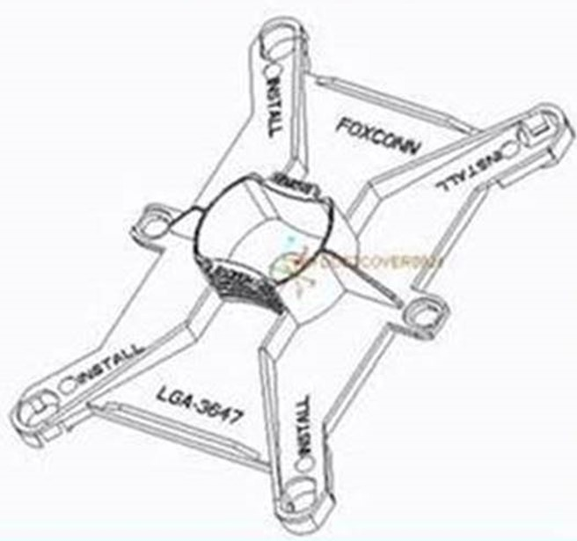
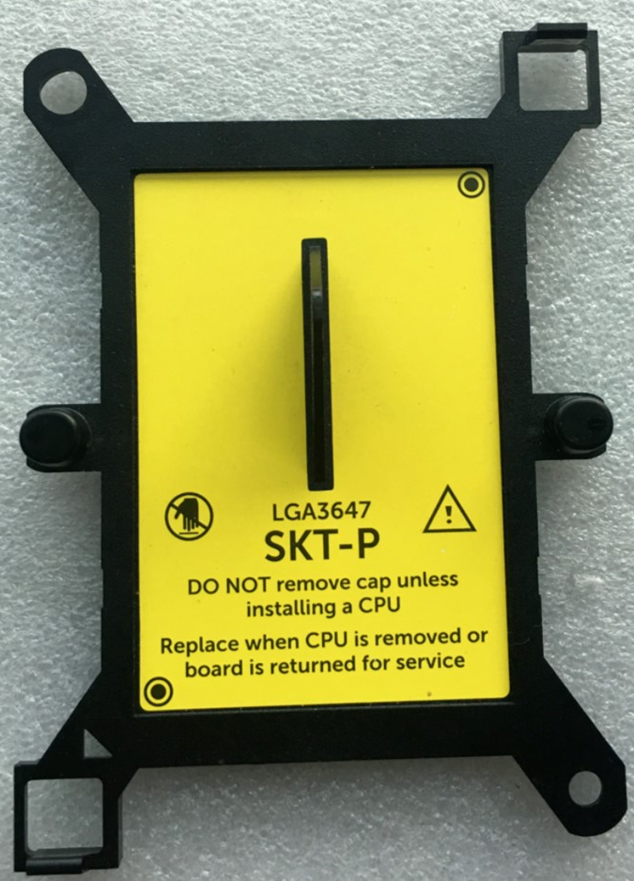
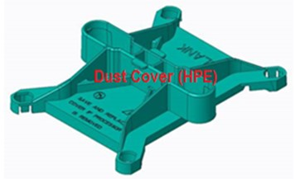
Next Step
Conduct CRD survey for L10 factory in US region, to understand automation practice, requirement & trend.
Need continues support for assembly test tool development (Whitley → Eagle stream → future platform). Possibly address customer concerns for breaking PEEK nuts issue.
Seek customer clarification for PnP cover (new) and socket cover concerns (if this is existing/new issue).
DELL – available in eBay
Foxconn
design
Example of Purley socket cover improvement request
HPE design
Notes:
No need customer name
Shenmao paste not prefer..wording edit

Slide 21
Rev Tracking
# | Rev | Date Released | Change Description
1 | 0 | W26 Y2020 | New doc
2 | 1 | W32 Y2020 | Updated machine information and (page 4 & 6, in blue)

